Slide 1
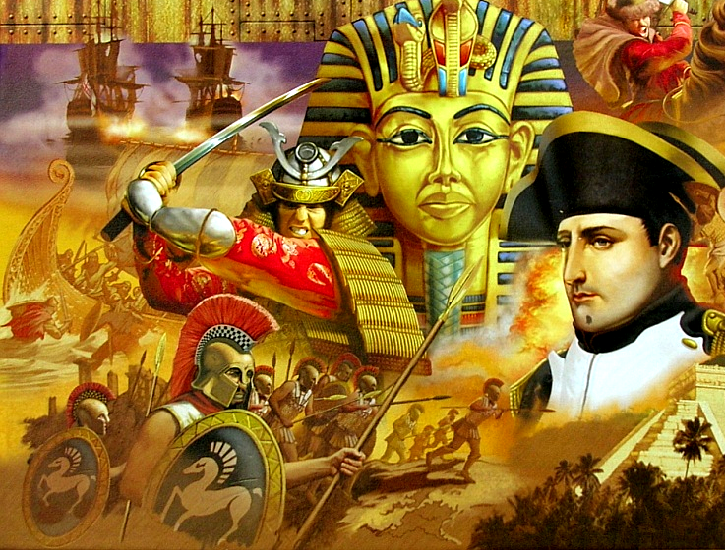
Introduction to history
L.G: To define history and key time terminology, to know what each letter of S.M.A.R.T. goals stands for.
C.S: Glossary page set up with key definitions added.

Slide 2
Classroom expectations

Slide 3
PowerPoint expectations
If the text is in BLUE then you need to copy it down.
If the text is in RED then it is a task to do.
If the text is in GREEN then it is a discussion point.

Slide 4
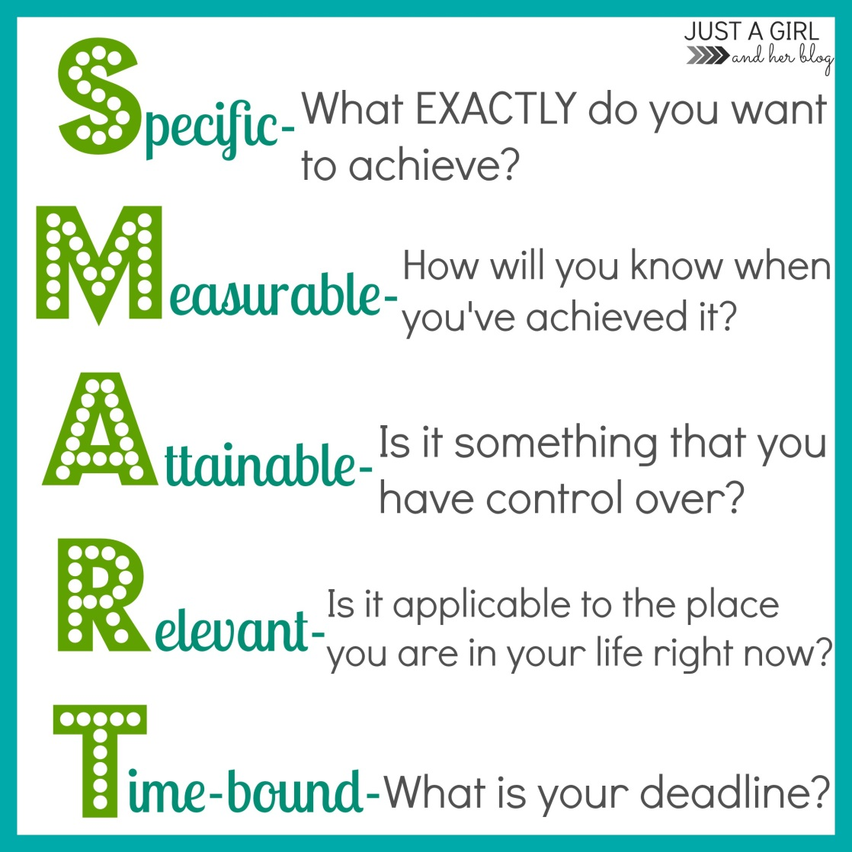
S.M.A.R.T. Goals
S.M.A.R.T. Goals are useful to set as they help us choose goals that we will be able to succeed at.
Copy and complete the following table in your books
S.M.A.R.T. Goals
Specific
Measurable
Attainable
Relevant
Time-bound

Slide 5
Create a brainstorm about history
What is History?

Slide 6
KWL – the ancient world
(What I know, what I want to know, what I’ve learnt)
I KNOW:
I WANT to know:

Slide 7
Glossary
Turn to the last page in your HASS book
Title it ‘Glossary’
Using a ruler divide your page into two columns
Label them as seen below
Finish each definition before you write the next term
Term | Definition
History
Ancient history
Modern history
Chronology
Decade
Century
Millenium
The study of significant people and events in the past and their impact on how we live today.
The study of the people and events in the ancient world up to the fall of Rome in476 AD.
The study of people and events following the end of the Medieval Period to the present day.
Arranging dates in order of when they happened..
A period of ten (10) years..
A period of one hundred (100) years..
A period of one thousand (1000) years..

